Slide 1
Mental Health in the
Workplace
Jessie Liroff, Sean Lei, MJ Ramos and Cossella Bensan

Slide 2
Motivation
Mental health awareness has become an increasingly important issue in today’s society. Our motivation behind this project was to unravel how much of a presence there is of mental health disorders, specifically in the workplace.
First, what is a mental disorder? A mental disorder is a physical illness of the brain that causes disturbances in thinking, behavior, energy or emotion that make it difficult to cope with the ordinary demands of life.
Originally, our topic was Mental Health in Tech. However, the data source we used didn’t have sufficient data to filter different types of organizations, so we broadened our topic to the general workplace.

Slide 3
Research Questions
Elaborate on the questions you asked, describing what kinds of data you needed to answer them, and where you found it.
How does the frequency of mental health disorder vary?
We focused on age, gender and company size.
What are the strongest predictors of mental health disorder or certain attitudes towards mental health in the workplace?
We focused on people who currently have a mental disorder, how aware they are of their mental healthcare options, and if productivity at work is an issue.

Slide 4
Data Set Used
https://www.kaggle.com/osmihelp/osmi-mental-health-in-tech-survey-2018
OSMI (Open Sourcing Mental Illness) - https://osmihelp.org/
Non-profit, 501(c)(3) corporation dedicated to raising awareness, educating and providing resources to support mental wellness in tech communities.

Slide 5
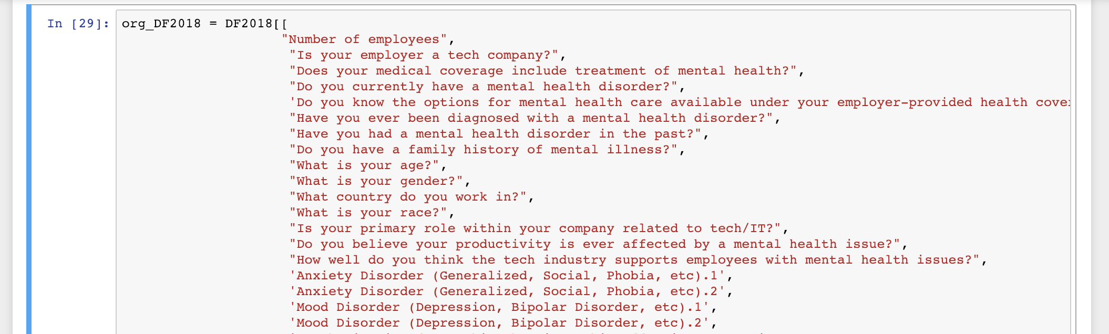
Data Exploration
Combined 2 years worth of data (2017 and 2018).
Each data set had 123 columns
Reviewed each column to decide which data would be relevant to our project.
Example of a columns we removed:
“Describe the conversation with coworkers you had about your mental health including their reactions.”
Notes:
“If you have revealed a mental health disorder to a client or business contact, how has this affected you or the relationship?'

Slide 6
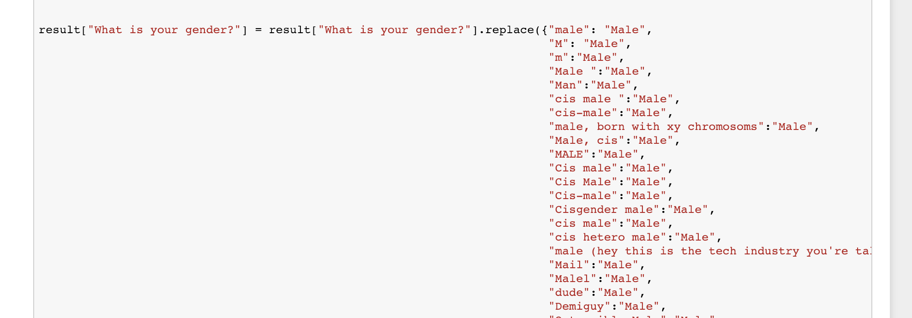
Data Clean-up
There were inconsistencies in the participants answers that needed to be cleaned up.

Slide 7

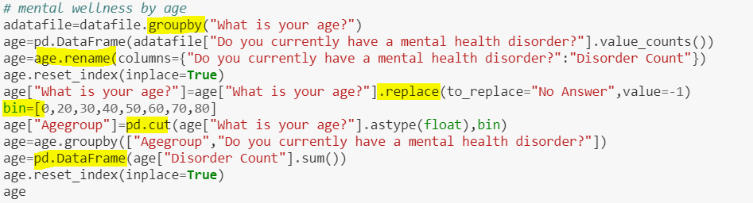
Data Analysis
Analyzing Steps:
Validation of Data Quality
2. Data Mining & Visualization

Slide 8
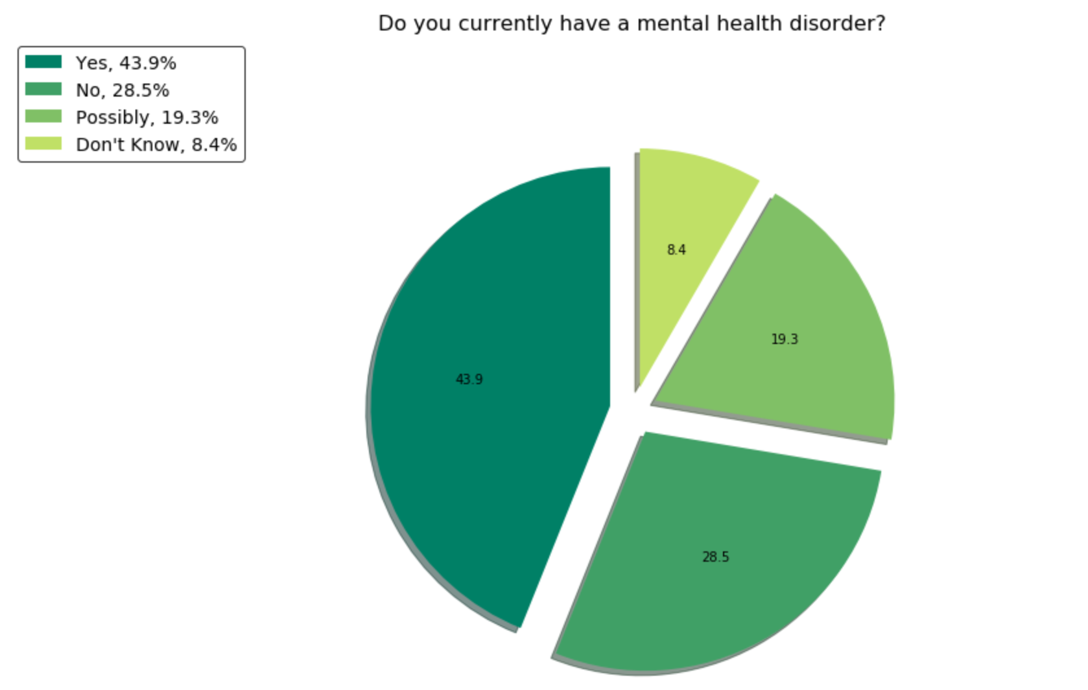
Mental Wellness Status Quo
Participants who reported having a mental illness: 43.9%+19.3%= 63.2%
Less than 30% of the people say that they do NOT have a mental illness.

Slide 9
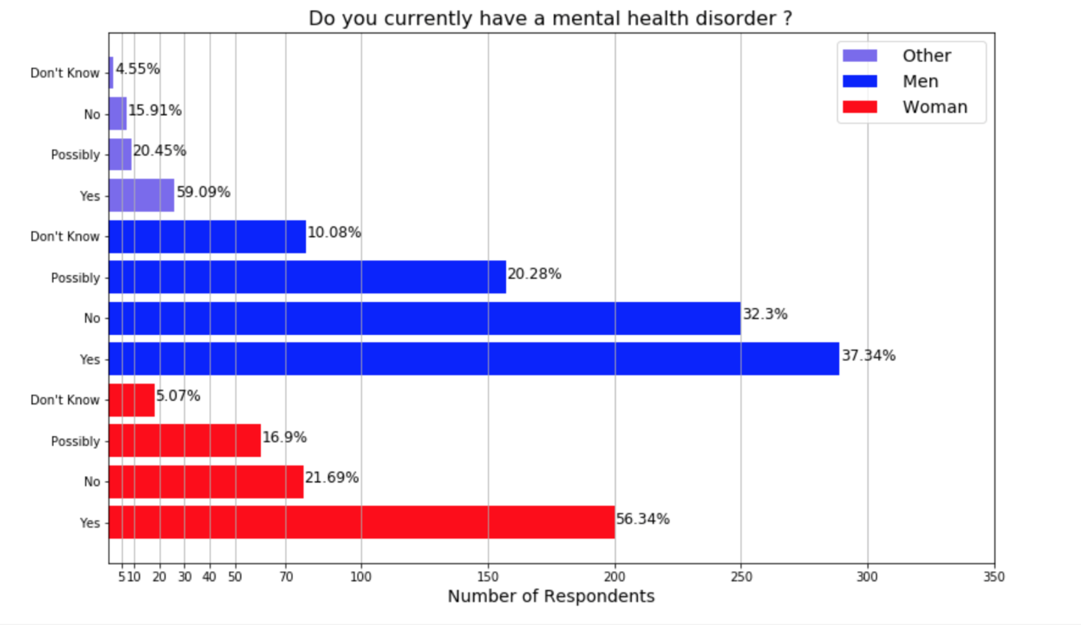
Gender
56% of women reported ‘Yes’ to a mental health disorder compared to 37% of men
The percentage of men who reported they ‘Don’t Know’ is double the percentage of women
10% more of men than women reported ‘No’
59% of people in the Other category reported ‘Yes’

Slide 10
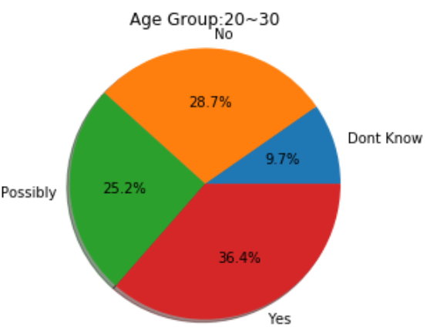
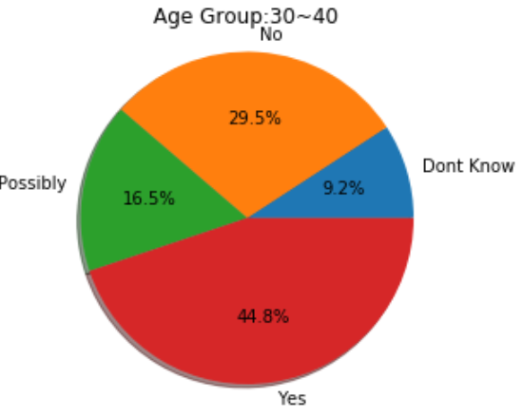
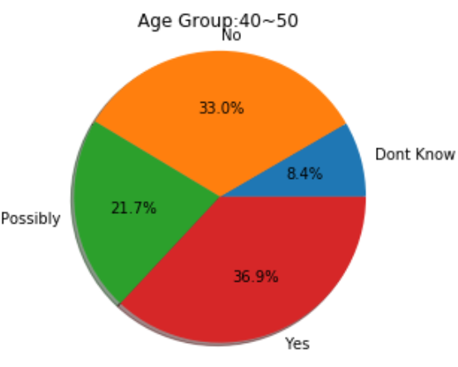
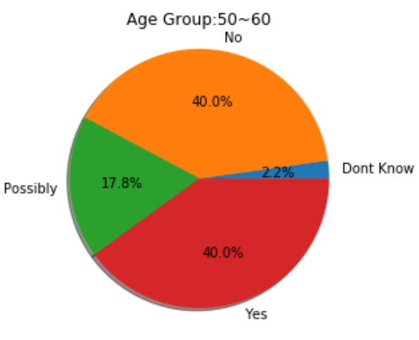
Age
No significant variances among
different age groups in terms of
mental wellness.
Age group 30~40 seems to show the highest
level of mental disorder.
Younger people seem to be more uncertain
about their health level (35% didn’t
give “yes” or “no” answer in age group
20-30) while older participants appear
to be more clear about their mental
wellness (20% didn’t give“yes” or
“no” answer in age group 50-60).

Slide 11
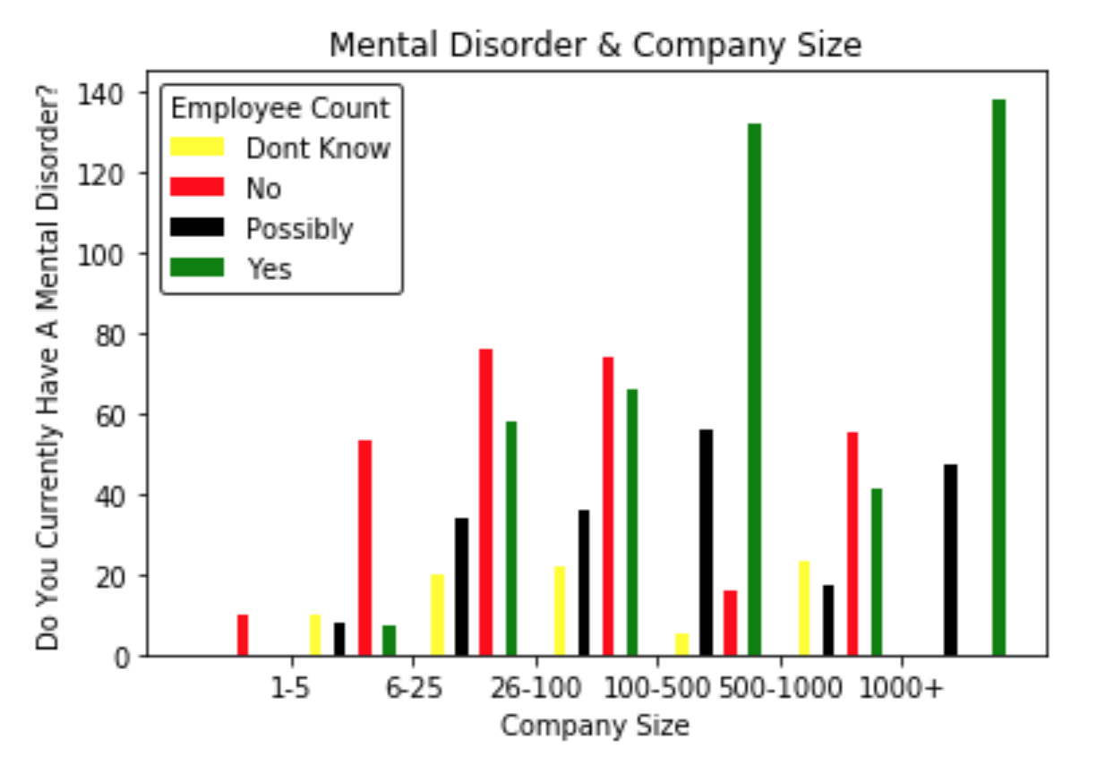
Company Size
52% of people in companies larger than >500.
38% of people in companies <500 people.
The number of people with mental health disorders increases as company size increases.

Slide 12
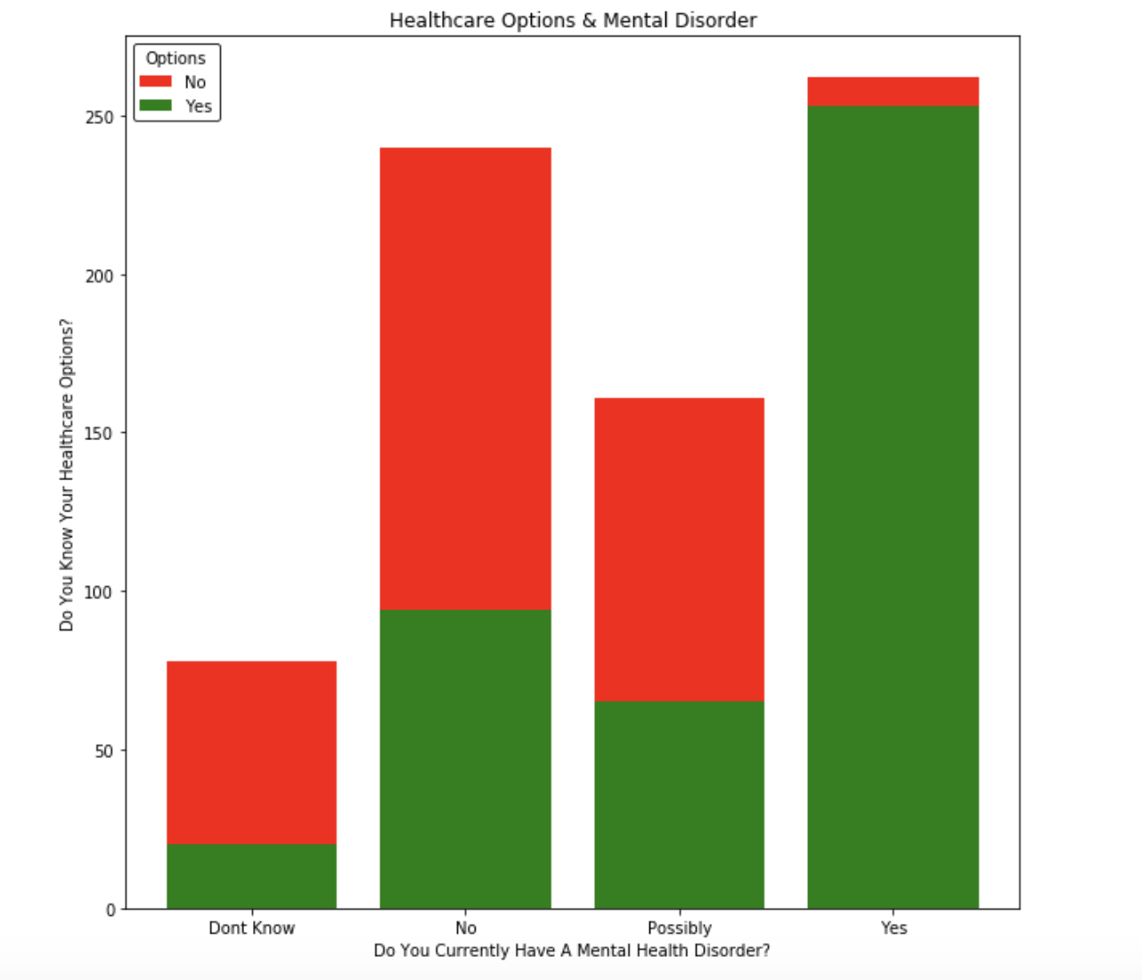
Health Care Options
20% of the people who responded ‘Don’t Know’, ‘No’, or ‘Possibly’ to having a mental health disorder know the mental health care options available to them.
50% of people who responded ‘Yes’ to having a mental health disorder know the mental health care options available to them.
If people knew the mental health care options available to them, would more people respond ‘Yes’ to having a mental health disorder and seek treatment?

Slide 13
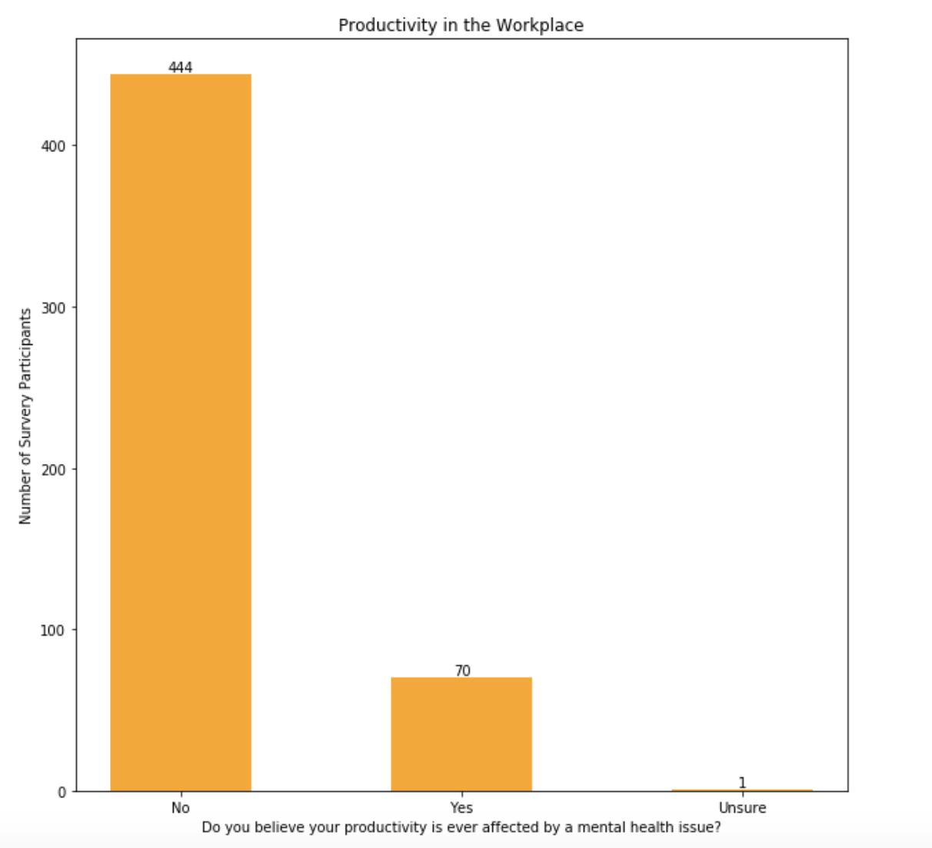
Productivity
Of the 515 participants who reported that they had a mental illness only 70 (13%) said that it affected their productivity.
Mental illness doesn’t seem to affect productivity.
We may also be able to assume that those who report that they have a mental illness are seeking treatment. Meaning that their mental illness is less likely to get in the way of their day-to-day.

Slide 14
Discussion
Did you find what you expected to find? What inferences or general conclusions can you draw?
Yes.
Women, people in their 30’s - 40’s, and larger companies are the more prevalent groups with mental health disorders in the workplace. This could be for a number of reasons. . .
People who do not have a mental disorder are not aware of their mental health coverage options until they need it.
Having a mental health disorder in the workplace does not affect productivity for a good majority of the people.

Slide 15
Post Mortem
DIFFICULTIES
Selecting the right questions in the dataset to come up with a narrative behind the data
Not having enough time to analyze more data and create new graphs
Creating graphs that clearly represented the data in question
Solution: Focused on the work we already had, attempting more analysis and graphing, and thinking critically on how to best present it.
Positive Takeaways:
Delegating work
Submitting deliverables on time
Overcoming challenges together as a team
RESEARCH QUESTIONS TO FOLLOW
Which mental health disorders rank highest in the workplace?
When not treated effectively, how often does it interfere with work productivity?
Which industries have more/less people with mental health disorders working for their company? Is there a correlation?

Slide 16
Questions
Open-floor Q&A with the audience

